Slide 1
How to estimate the Direct-to-Total Labor Ratio using India Government Economic Statistics
Step 1
Record the values of Annual payroll and Production workers annual wages
Step 3
Calculate the Direct-to-Total Labor ratio for the industry
Obtain the latest available India Government Economic Statistics
Step 2

Slide 2
Select the Industry Code Based on the Supplier’s Business and Product
Step 1
1. Go to
2. Click on “Microdata Catalog”
3. Search for “Annual Survey of Industries”
http://microdata.gov.in/nada43/index.php/home

Slide 3
Select the Industry Code Based on the Supplier’s Business and Product
Step 1
4. Click on “Datasets”
5. Search for the latest “Annual Survey of Industries” – in this case 2017-18

Slide 4
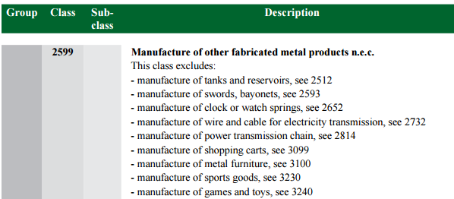
Select the Industry Code Based on the Supplier’s Business and Product
Step 1
6. Scroll down and click on “Nic_2008” to open the PDF file
7. In the PDF file, Use Control + F to search for keywords to locate the industry of interest and record the 4 digit respective NIC code for the industry of interest.
(e.g- NIC code- 2599 – “Manufacture of other fabricated metal products n.e.c”)

Slide 5
Use Financial and Manufacturing Information to Calculate Ratios
Step 2
In India, follow the steps below to find DL to TL ratio. Steps: 1–3
1. On the same webpage, scroll up and look for “Annual Survey of Industries 2017-18 Volume – I”. Click on the pdf icon to access the latest publication of industry statistics

Slide 6
Use Financial and Manufacturing Information to Calculate Ratios
Step 2
2. In the PDF file, Scroll down to locate “Table 3: Estimate of (i) employment, (ii) mandays employed and (iii) emoluments paid in the factory sector by their type for each 4-digit industry class (NIC-2008) for all-India”
Record the following values for NIC code 2599:
C. Wages and Salaries including Employers’ Contribution
1.1.1. Workers (Wages to workers)

Slide 7
Calculate the Direct-to-Total Labor ratio for the industry
Step 3
Divide ‘Worker wages’ by ‘Wages and Salaries including Employer’s Contribution’
1.
 | Worker wages | 293181
 | Wages and Salaries including Employer’s Contribution | 655873
 | Direct-to-Total Labor Ratio | 44.7%

